Slide 1

News room
Group Members:
Mohit Kumar Sinha
Raghav Mewar
Pranay Banuru
Oshin Singh
Given By:
Asfiya Khan
Evaluators:
Ashumeet
Kiran Kumar (Trainer)

Slide 2
News room project brief
In our project we have made a News Room application with the web development technologies.
Our News Room interface consist of Login page(User and Admin) , Home page and Forget Password page.
Our project interface has smooth contacting with backend technologies like jquery ,ajax , js which gives the project dimensionality.
The News we fetch in our project is from News APIs .

Slide 3
Technology AND SOFTWARE used!
HTML
CSS
JAVASCRIPT
BOOTSTRAP
JQUERY
AJAX
GIT (VERSION CONTROL)
VS CODE

Slide 4
Version control system used!- GIT
Git as an open source version control system been used in our project for coordinating, managing and tracking the work.
GIT branching feature helped us to create branches to distribute work flow and merge them.

Slide 5
LOGIN PAGE
In this project the login page divided as user login and admin login .
We have used bootstrap, html, css as an frontend technology.
In the login page we have displayed date , time , location and weather.
For the date & time and weather we have api call .
In this page as soon as we enter the username and password it should pass the page validation and move to the Home Page.
Forget password feature displayed .

Slide 6
LOGIN PAGE
(backend)
For the login page backend part , the work is to authenticate valid users.
For the authentication part we need to set up json server with json file which will have valid user and admin datas to match with.
For calling weather api ,the work is to render weather description, temp data ,location and dynamically fetch weather icon according to weather
For date and time display , the work is to call date & time api and convert to date & time format ,the callback happens for every 1 second.
We have used ajax , jquery for the authentication of login details and API call of the date, time and weather in login page

Slide 7
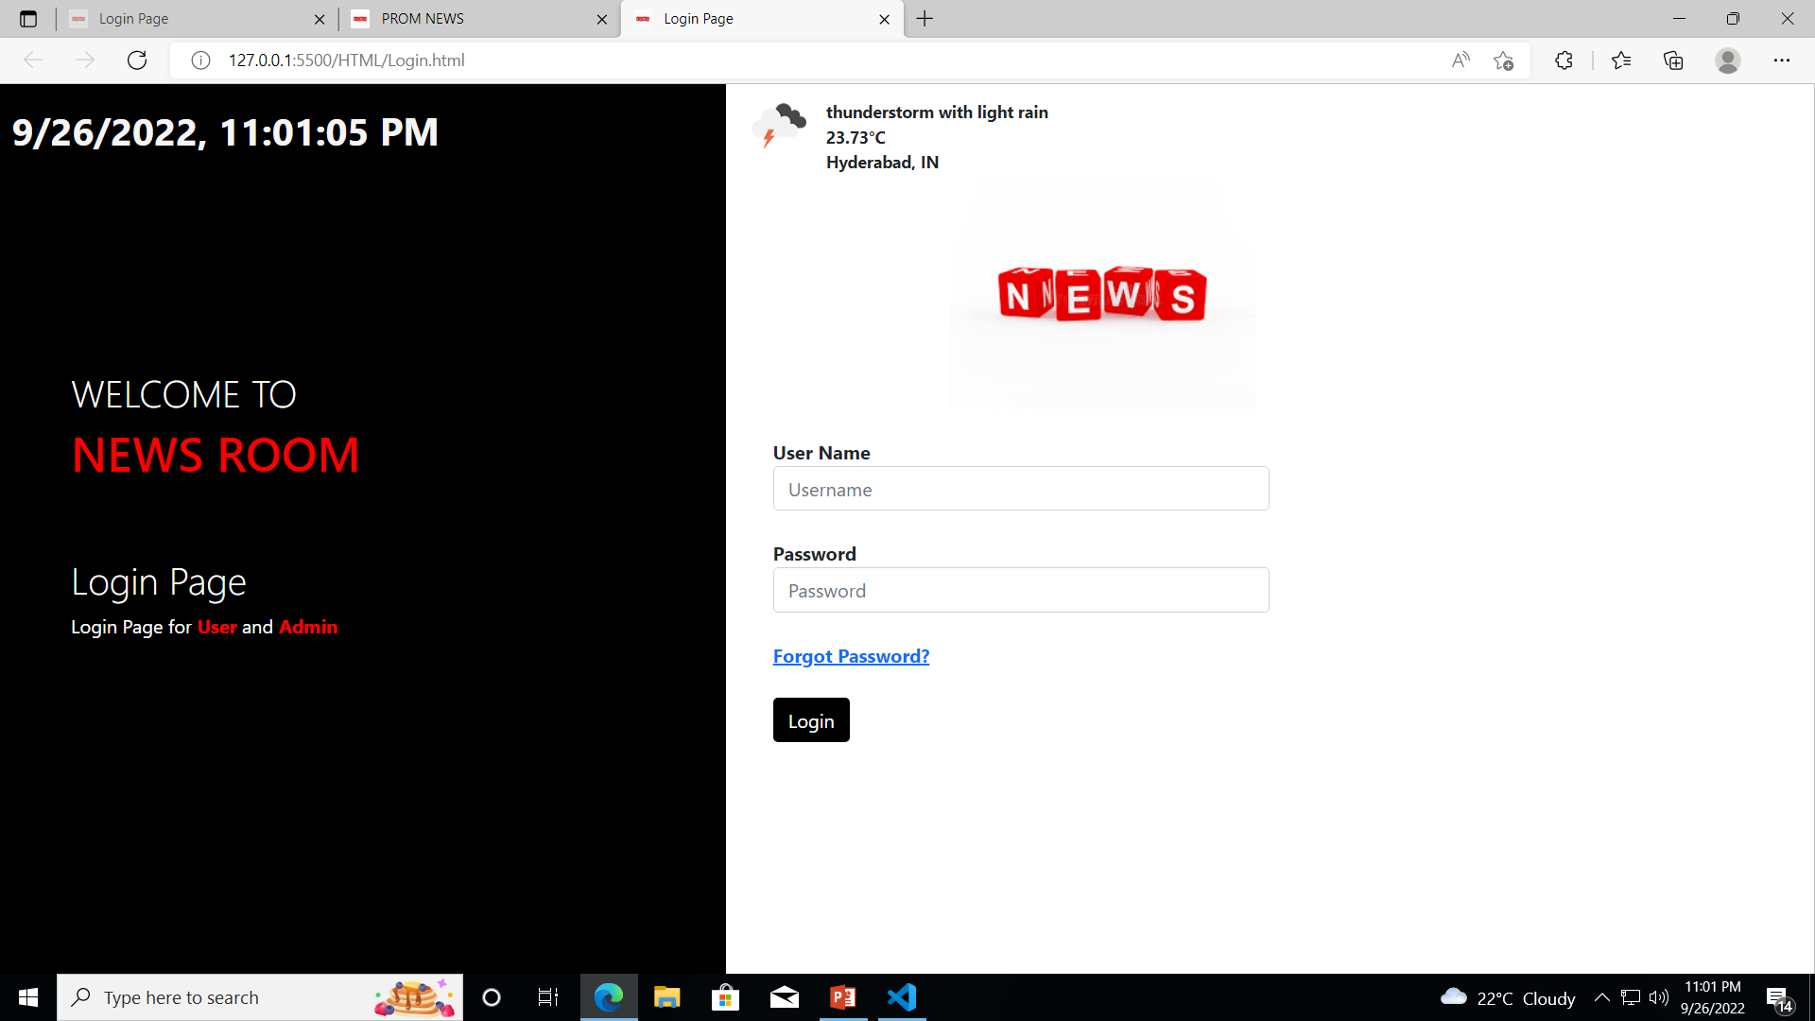
LOGIN PAGE OF NEWSROOM

Slide 8
HOME PAGE
The first thing in the home page we have is a search bar with our news logo.
The categories of news application is listed in navigation bar the categories include trending , technology, business ,entertainment, health , science and sports.
Click on one of the categories to view that respective category news article which will refresh on to the same page.
The top news are displayed on flip cards with title , author and publish date.
Date & time, weather and location on the page
The footer part contains the copyright and symbols of social media icons.

Slide 9
HOME PAGE
(backend)
As of the backend part , for fetching the news data we have used NewsApi.org .
As soon as we login into the main page, JSON based News API is called for searching and retrieving top news articles on the interface.
For the categories of Home Page which is in navigation bar , for this click listeners are created so that for each category respective topic News Api get fetch to the page and display.

Slide 10
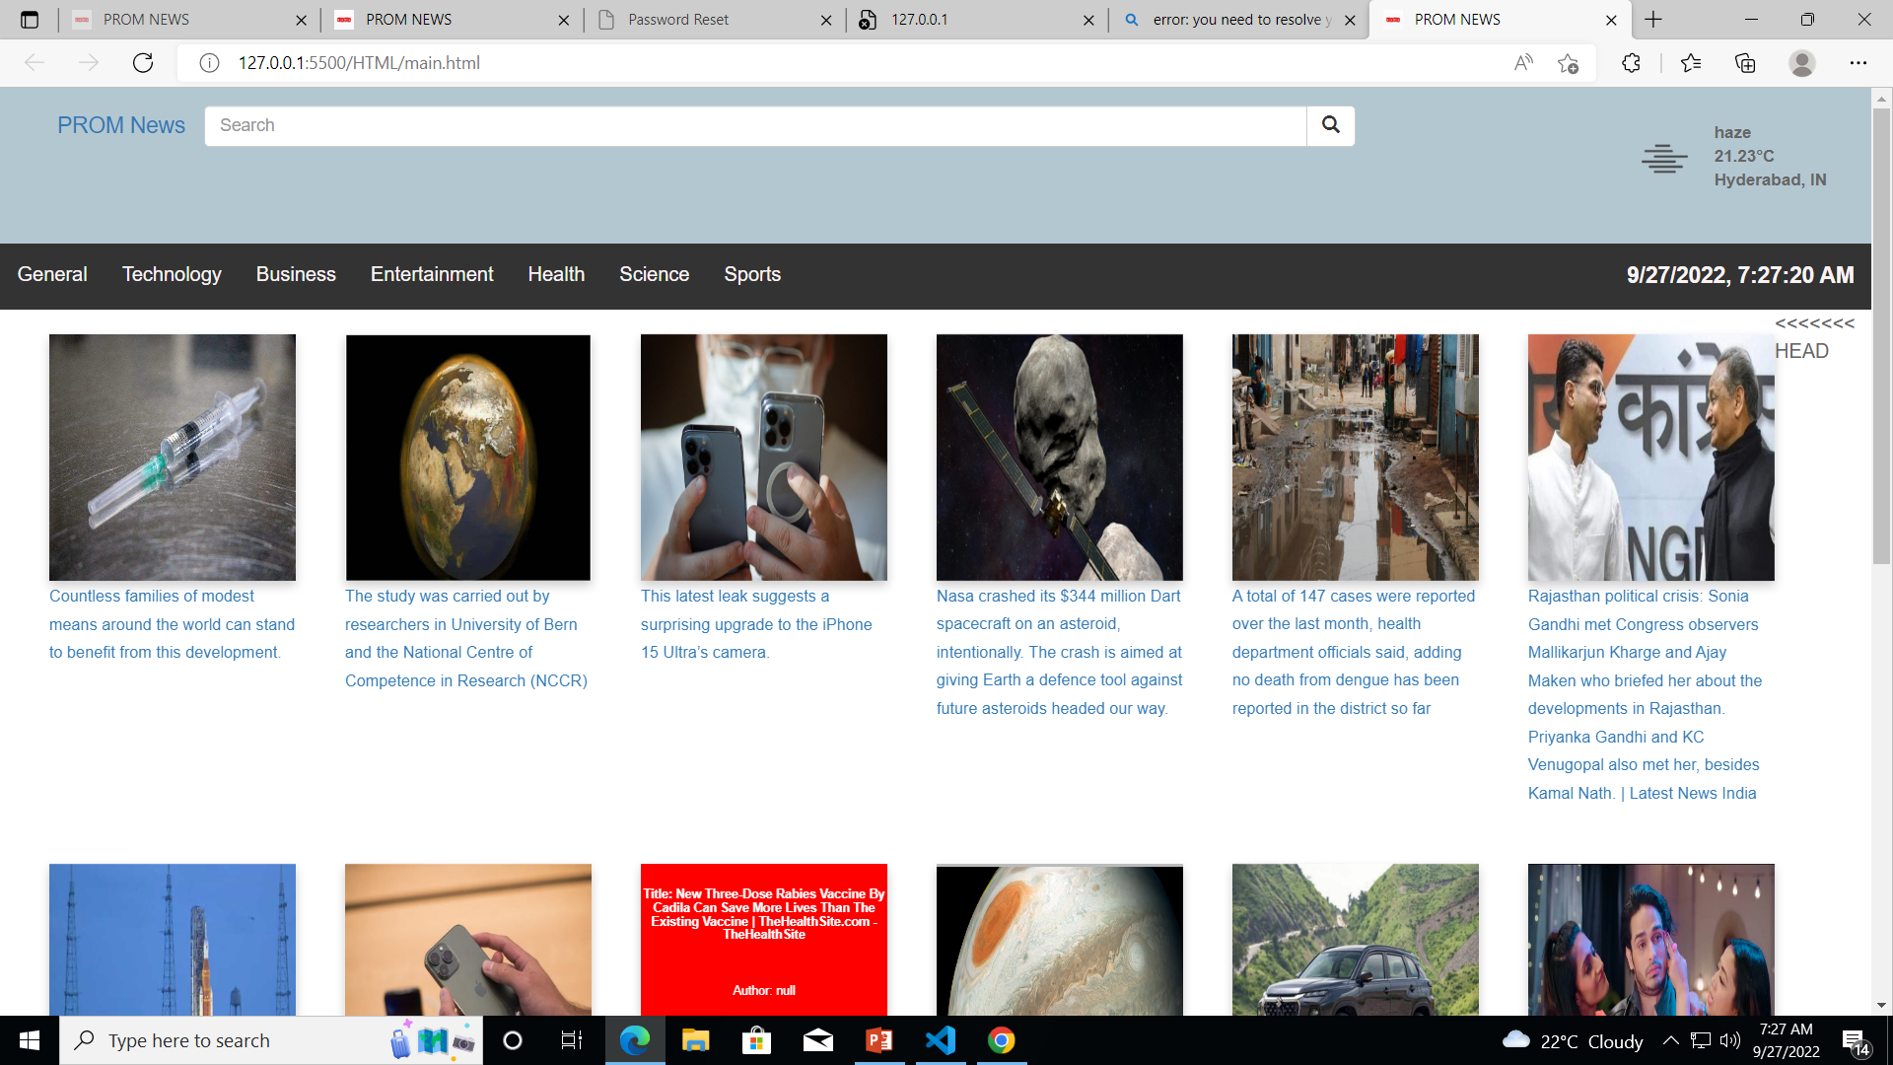
HOME PAGE Of NewsRoom

Slide 11
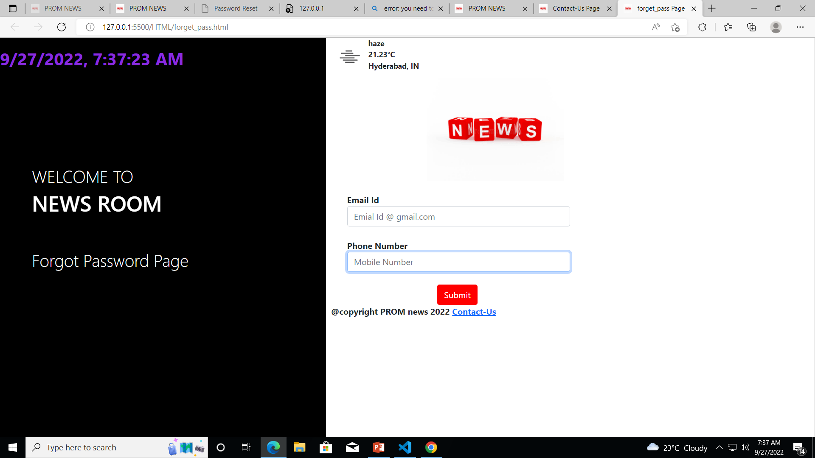
Forget Password Page

Slide 12
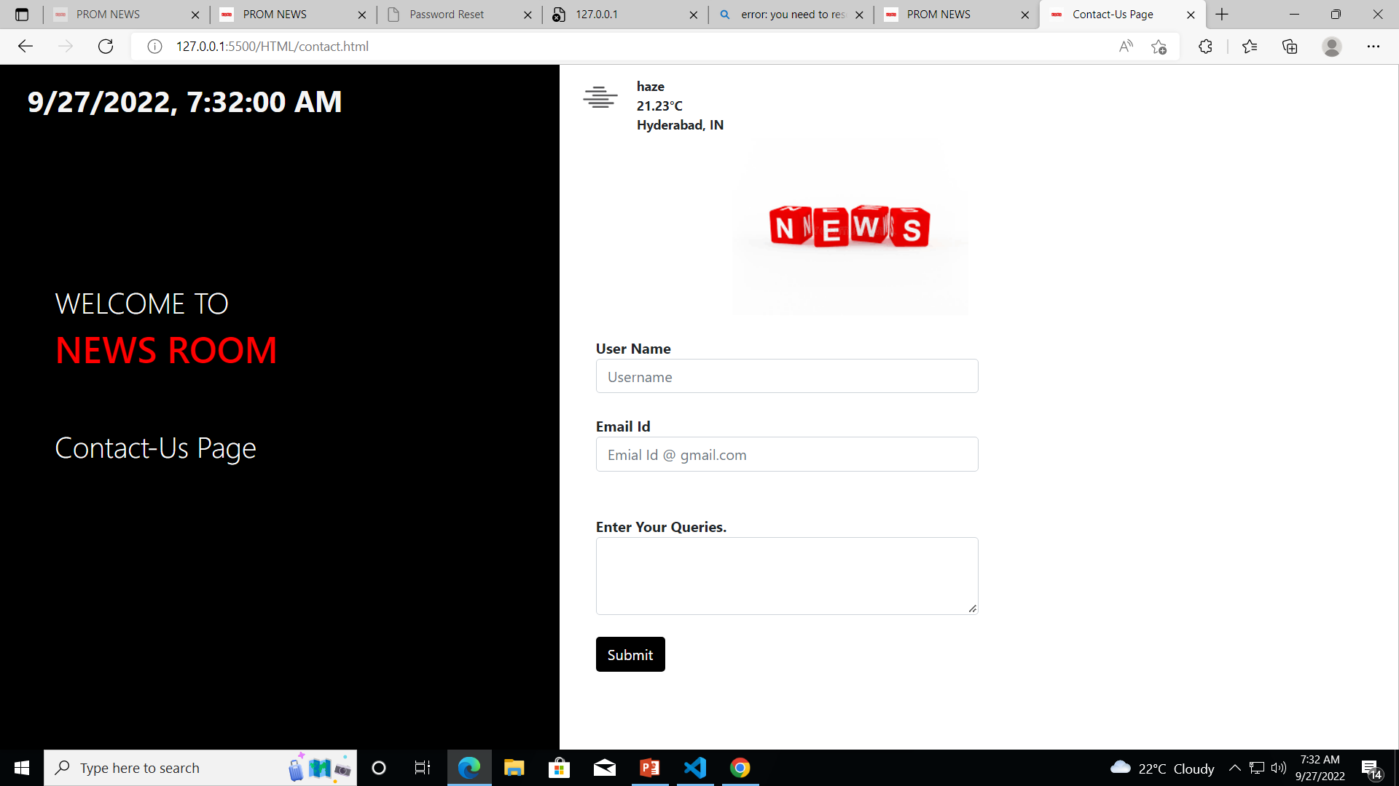
Contact Us Page

Slide 13
Problem Faced!
CRUD operations setup in admin backend
Fetching news API and inserting into the home page elements
With the responsiveness(RWD) of the pages
Hashing with the passwords for login authentication.

Slide 14
THANKYOU!

